Slide 1
Cloud Platform as a Service

Slide 2
Agenda
Define
Strategize
Prepare
Next Steps

Slide 3
Definitions & Basics
“The Cloud” is growing even though the term cloud has been overused and overhyped. Enterprises of all sizes are evaluating the potential of cloud computing for greater flexibility, speed, and lower costs in service delivery.
Cloud computing is categorized into three types of externally-hosted services:
Software as a Service (SaaS)
Infrastructure as a Service (IaaS)
Platform as a Service (PaaS).
Interest in exploiting cloud computing is high both within IT and the business as a whole. IT leaders must evaluate if the cloud:
can indeed be used for cheaper and faster development and delivery.
allows for development of more efficient and effective applications.

Slide 4
Saas | PaaS | IaaS
Software model where licenses are distributed on a subscription basis | Virtualized application development environment | Virtualized computing services
Third-party vendor is responsible for: application support and dev lifecycle | Third-party vendor is responsible for: OS, Server-side scripting, environment Db management system, Server Software, Support, Storage, Network access, Tools for design and development, Hosting | Third-party vendor is responsible for: virtual server space, network connections, bandwidth, IP addresses and load balancers.
Licensed per user | Pay by the hour or month | Numerous options

Slide 5
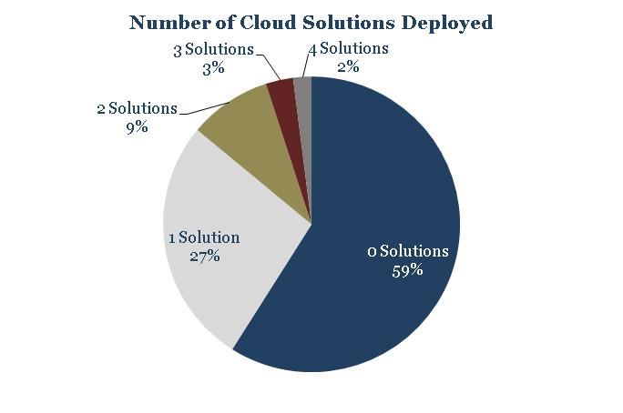
Adoption Rate
n=123
Source: Info-Tech Research Group

Slide 6
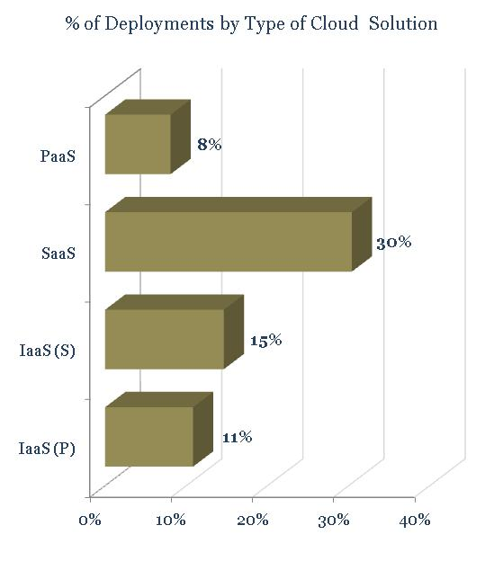
Adoption Rate
n=123
Source: Info-Tech Research Group

Slide 7
SaaS, PaaS, and IaaS are analogous to the three traditional layers of application delivery within the enterprise -- hardware, middleware and application.
End Users
End Users
Applications
Middleware
Program Framework (e.g. .NET), Database Objects, Web Services.
Software as a Service
Platform as a Service
Hardware Infrastructure
Servers, Networks, Storage
Infrastructure as a Service

Slide 8
Strategize
Talking about a cloud strategy is meaningless. Instead cloud services need to be evaluated for how they might help IT meet its business strategy.
Ask not what your PaaS strategy should be but what your application development strategy should be. Then ask how PaaS might play a role in executing that strategy.
The strategic goal of application development could be to effectively meet business needs through rapid and efficient development and deployment of applications that serve the business.
The end user is also a critical consideration for an application development strategy. Are applications being delivered on time? Are they doing what users need them to do? Can meaningful service improvement feedback be acted on rapidly?

Slide 9
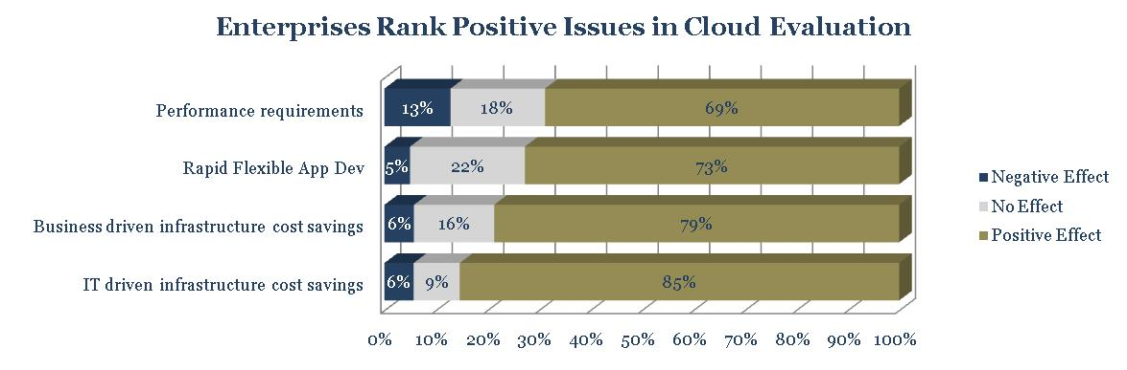
Fast Flexible Development
n=123

Slide 10
Cut out the Middle Men and Women
VMware President Paul Maritz has said that for an application development manager a number of necessary infrastructure sign-offs lay between application development project inception and action.
Project Inception
Storage Sign-off
Server Sign-off
Networking Sign-off
Purchasing Sign-off
(Possibly) CIO Sign-off
Project
Action
For the application development manager the very definition of cloud computing, says Maritz, “is not having to get those signatures.” An application project can go from requirements gathering, to modeling and design, to testing, and deployment without infrastructure hurdles.
Project Inception
Project
Action

Slide 11
Agile Development
Agile is an iterative technique for software development characterized by a focus on rapid delivery of incremental functionality and ability to adapt to changing realities.
Instead of a monolithic Waterfall approach delivering everything eventually, the idea behind Agile is to deliver more narrowly scoped pieces of functionality.
It is an iterative process with a tight feedback loop. As each small app is deployed feedback and use statistics are gathered to improve service and functionality of the next iteration.
Project teams and timeframes are necessarily tight – typically 3 to 5 team members and a six week time box.
Collaborative development and speed to value is aided by the use of a common programming platforms and development frameworks.
Platform as a Service
With PaaS, an application goes rapidly from modeling, to coding, to “push button” deployment. This is ideal for a rapid dev/deploy strategy.
SaaS-style deployment can yield detailed statistics on application usage by end users – not only of whether they are using the app but how they are using it.
Changes and additions to the application gleaned from user feedback and statistics can be automatically deployed to the end user in a SaaS model (There is no installation. Changes simply appear the next time they use the application).
Project is tightly focused but geographically dispersed project teams can work on agile projects. The jointly accessed PaaS is their connection point.
The PaaS provides the common programming tools and the development framework used by the agile development team.

Slide 12
Prepare
Strategic Fit
Review App/Dev Strategy
Ensure good fit
Compare TCO
Vendor Options
Make Case
Create Biz Case
Go/No-Go
Build vs. Buy

Slide 13
Next Steps
The Cloud will continue to expand and change. Keep an eye on the market and organizational strategy.
Establish timeline and criteria for cloud evaluation
Cloud is still in infancy, look for maturity in coming years
Optimize internal processes for cloud deployments
Examine data integration requirements

Slide 14


